Slide 1
BOOTCAMP
ACE ENGINEERING COLLEGE
TOPIC : DATA INTELLIGENCE AND AI

Slide 2
Day 5: Core Concepts of Artificial Intelligence & Machine Learning
1. What is Artificial Intelligence (AI)?
Artificial Intelligence (AI) is the field of computer science that enables machines to perform tasks that typically require human intelligence, such as:
Learning from data
Problem-solving
Decision-making
Understanding language
Recognizing images and speech
Examples of AI
Voice assistants (Siri, Google Assistant)
Self-driving cars
Recommendation systems (Netflix, YouTube)
Chatbots

Slide 3
2. What is Machine Learning (ML)?
Machine Learning is a subset of AI that allows computers to learn patterns from data and make predictions without being explicitly programmed for every rule.
Traditional Programming (Hard-Coded Rules)
Input + Rules → Output

Slide 4
if temperature > 35:
print("Hot")
else:
print("Not Hot")

Slide 5
Machine Learning Approach
Input + Historical Data → Learning Algorithm → Model
The model learns patterns automatically.
Example:
Input: House size, bedrooms, location
Output: House price
The algorithm learns the relationship between inputs and outputs from past examples.

Slide 6
Hard-Coded Rules vs Machine Learning
Feature | Hard-Coded Rules | Machine Learning
Rules | Written by humans | Learned from data
Flexibility | Low | High
Data Requirement | Minimal | Large datasets
Adaptability | Poor | Good
Suitable For | Simple tasks | Complex patterns

Slide 7
3. The Machine Learning Development Pipeline
Step 1: Collect Data
Example dataset:
Hours Studied | Marks
2 | 35
3 | 45
4 | 50
5 | 60
6 | 70

Slide 8
Train / Test / Split
Step 2: Split Data
Data is divided into:
Training Dataset
Used to teach the model.
Typically:
70%
80%
90%
Testing Dataset
Used to evaluate model performance.
Typically:
20%
30%
Example:

Slide 9
Ratio of splitting
Dataset | Percentage
Training | 80%
Testing | 20%

Slide 10
Why Split Data?
If a model is tested on the same data it learned from, it may simply memorize the answers.
Testing data helps verify whether the model can make accurate predictions on unseen data.

Slide 11
ML Pipeline
Collect Data
↓
Clean Data
↓
Split Data(Train/Test)
↓
Train Model
↓
Make Predictions
↓
Evaluate Performance

Slide 12
4. Continuous Predictions Using Linear Regression
Linear Regression is one of the simplest supervised learning algorithms.
It predicts continuous numerical values.
Examples:
House prices
Salary prediction
Stock trends
Temperature forecasting

Slide 13
Understanding Linear Regression
Suppose we have data:
Experience (Years) | Salary (₹ Lakhs)
1 | 3
2 | 4
3 | 5
4 | 6
5 | 7

Slide 14
formulae
Y = mx + b
Where:
y = Predicted value
x = Input feature
m = Slope of line
b = Intercept

Slide 15
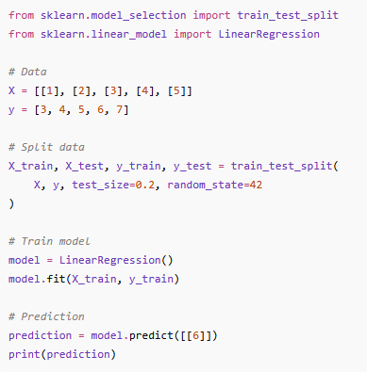
Linear Regression code

Slide 16
Metrics
Accuracy Score
Used mainly for classification problems.
Formula:
Accuracy = Correct Predictions -------------------- Total Predictions

Slide 17
Sample values in dataset
Actual | Predicted
Pass | Pass
Fail | Fail
Pass | Pass
Pass | Fail

Slide 18
Calculations
Correct Predictions = 3
Total Predictions = 4
Accuracy:
3/4 = 0.75
Accuracy = 75%

Slide 19
Error Margin
For regression problems we measure prediction errors.
Mean Absolute Error (MAE)
Average absolute difference between actual and predicted values.
MAE=∑∣Actual−Predicted∣ / n

Slide 20
Cal
Actual | Predicted
100 | 95
200 | 210
300 | 290

Slide 21
Cal
Errors:
5, 10, 10
MAE:
(5 + 10 + 10)/3 = 8.33
Lower MAE = Better Model

Slide 22
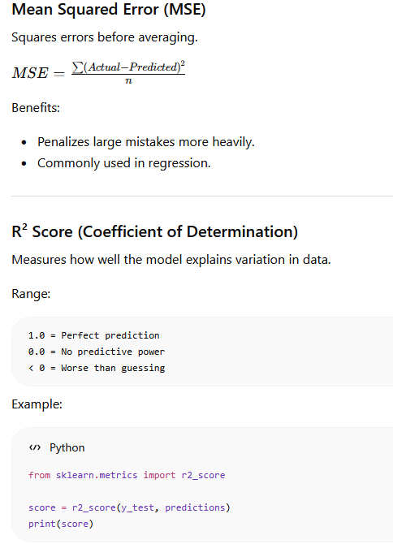
Metrics

